Slide 1


Slide 2

Image Classification Using SVM

Slide 3
Group Members Introduction
Ayesha Saleem
VU ID:Mc190405852

Slide 4

INTRODUCTION OF PROJECT
Image processing is a method of performing operations on an image in order to improve it or obtain useful information from it.
Image processing has various applications in fields such as medical, defense, industry, remote sensing, pattern recognition, and video processing, among many others.
In this project we will create an application that should identify different objects like rectangle, square and circle etc., based on their features from the input image.

Slide 5
INTRODUCTION OF PROJECT
Aim of the project is to classify four type of shapes of circle, square, rectangle and Star
Dataset contain 400 images 100 of each shape which further spilt into 70% for training and 30% for testing purpose
Histogram oriented gradient (HoG) feature extraction technique are used in this project
And support vector machine (SVM) are technique are used for classification

Slide 6
Functional Requirements
Four type’s shapes i.e., square, circle, rectangle and star type of image creation of different sizes using paint
Create dataset of 400 images of size 128x128
Extract features from the images using different built-in functions of MATLAB
Classify the images using Support Vector Machine (SVM) machine learning technique
Train SVM model using the training dataset. Test SVM model using the test dataset.
The system should also have the capability to test a single image

Slide 7
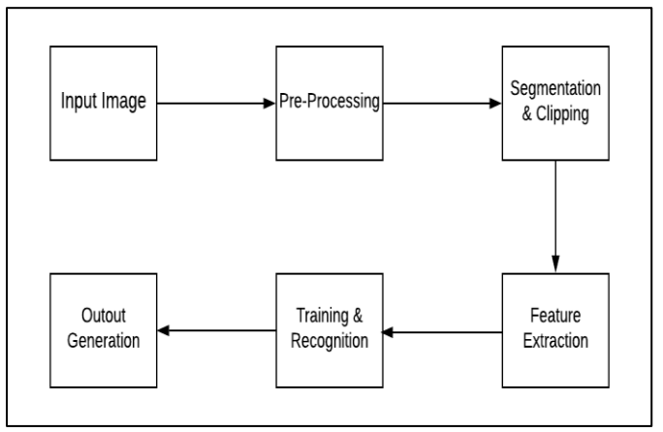
Process Diagram

Slide 8
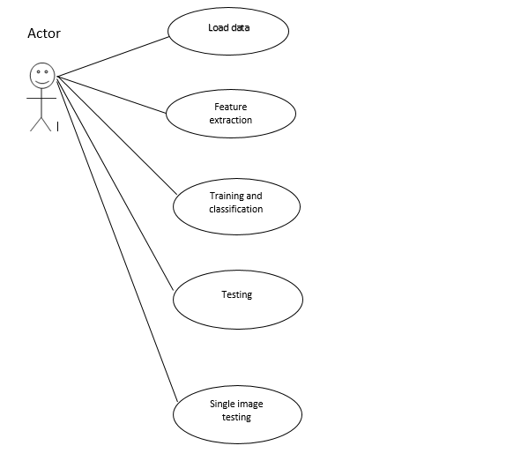
Use Case Diagram

Slide 9
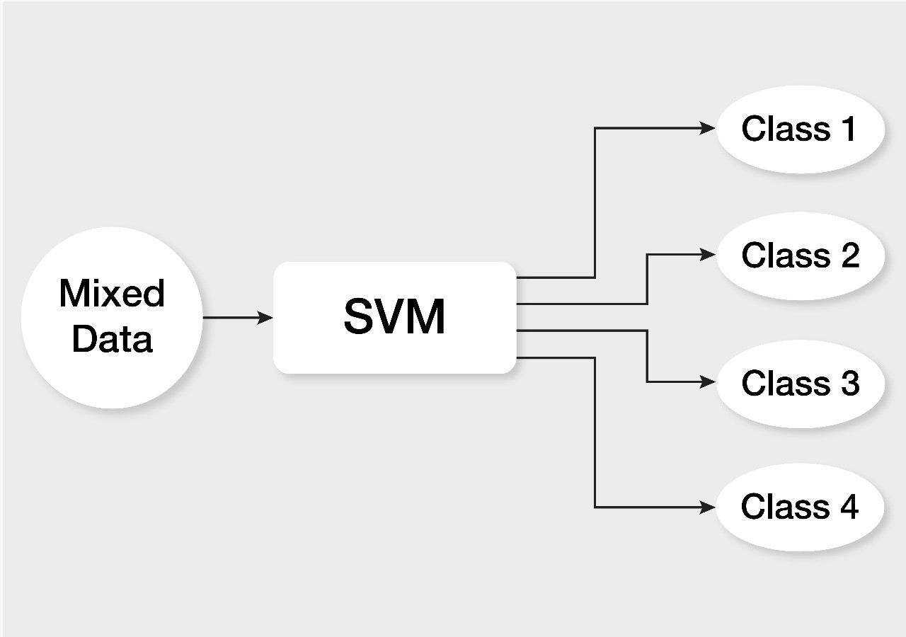
Architectural Design

Slide 10
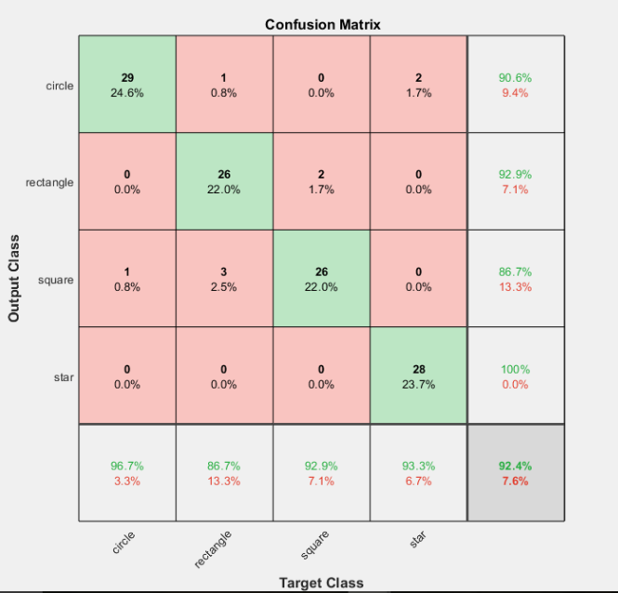
Testing Accuracy

Slide 11
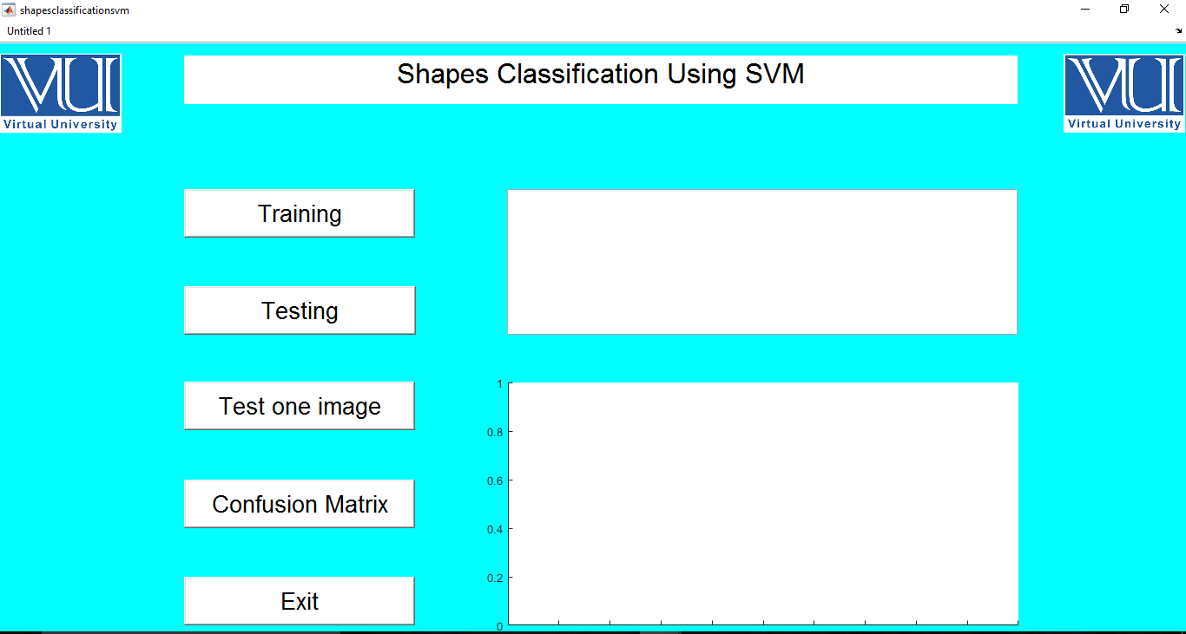
User Interfaces

Slide 12
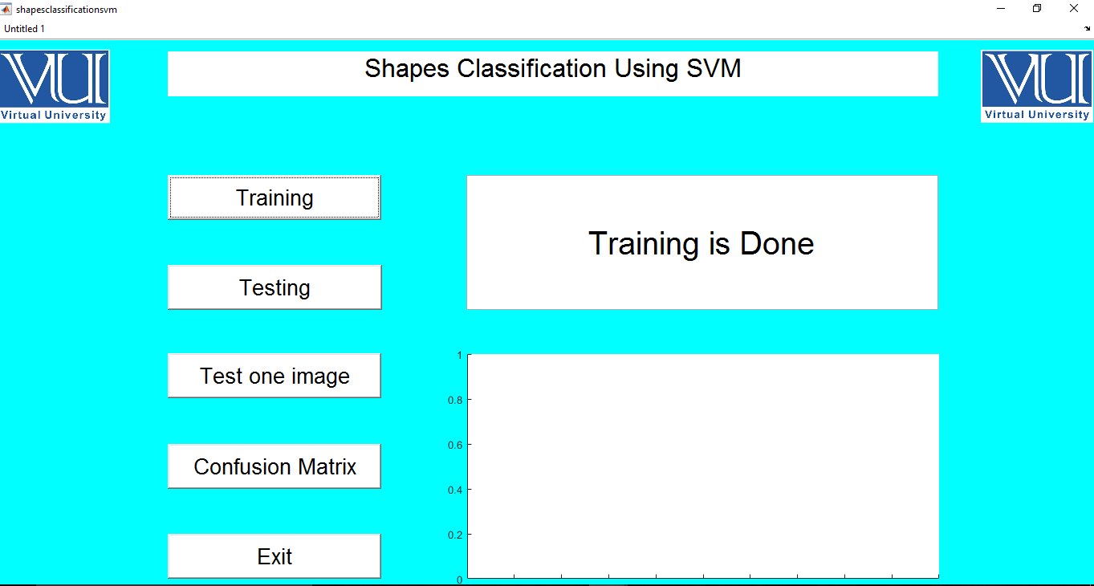

Slide 13
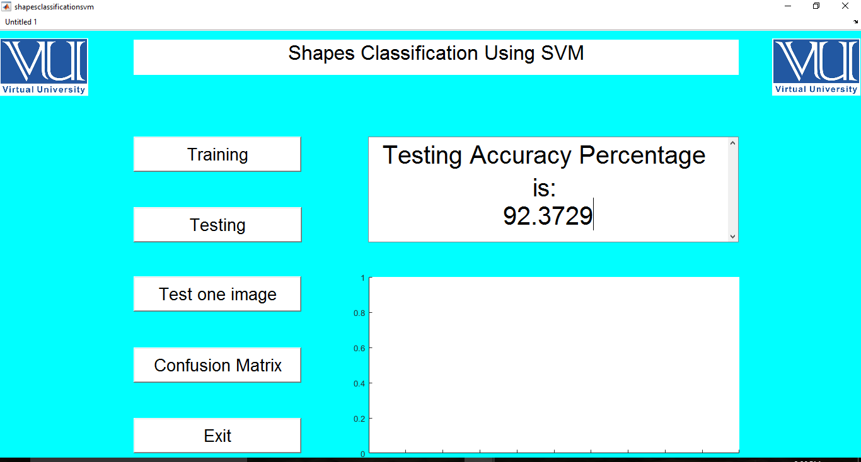

Slide 14
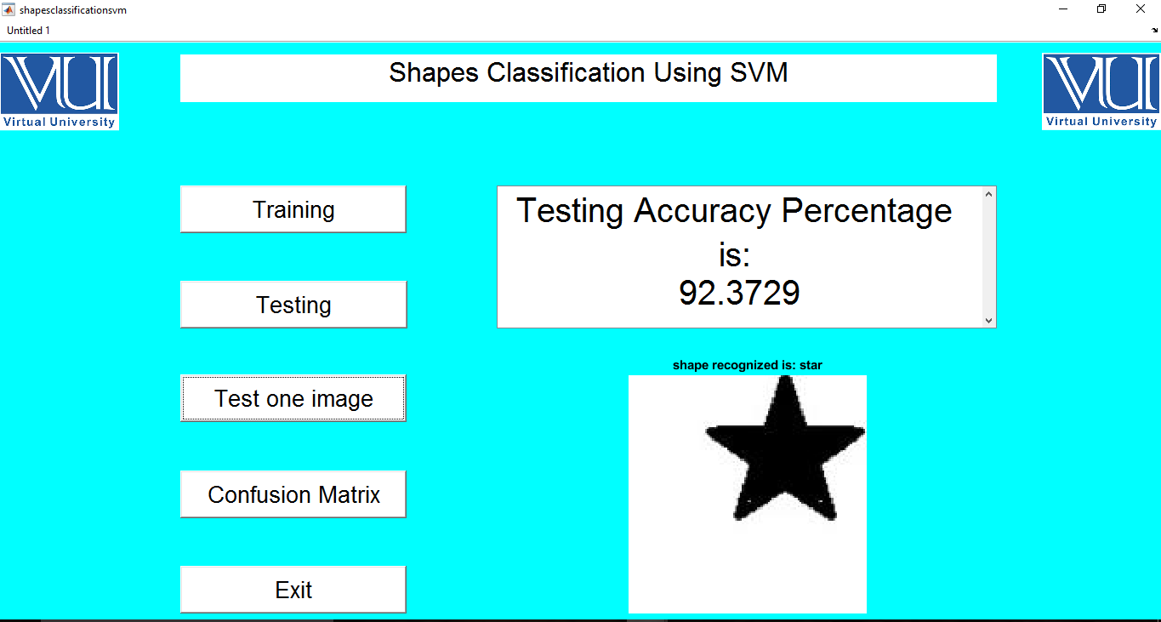

Slide 15
Tools
MATLAB
Paint

Slide 16
Thank You

